Slide 1
A Novel Nanoparticle Idea to Support the Role of IGF-1 and IGF Receptor on PTSD and Stress-altered Neural Changes
Eric Sandhurst
Nanoparticles in the Bran Theory Presentation
Friday, November 15th, 2019

Slide 2
The Story of Insulin and Insulin-like Growth Factor-1
The insulin/insulin-like growth factor 1 (IGF-1) signaling pathway is evolutionarily conserved in diverse species including C.elegans, saccharomyces cerevisiae, Drosophila melanogaster, rodents and humans.¹
IGF-1 is involved in many interrelated functions that are necessary for metabolism, growth, reproduction, and protective effects.
A growing body of research over the last 30 years has shown the IGF-1 signaling system to be a potent mediator of neurodegenerative diseases with a wide range of pleiotropic effects.
The signaling axis operates in both a paracrine and autocrine manner as IGF-1 is produced within all cells within the brain and acts locally, while endocrine IGF-1 travels to the brain to exert its effects. ^{2,3}
Considerable effort has been made to understand the role of the IGF axis in embryonic neural growth and development, as well as protection against certain neurodegenerative diseases associated with aging and stress resistance.
Notes:
A growing body of research over the last 30 years has shown the IGF-1 signaling system to be a potent mediator of neurodegenerative diseases with a wide range of pleiotropic effects. Although its mechanism of action during a human lifespan has yet to be completely understood, the extensive body research clearly indicates that it plays a significant role in many aspects of growth and development of various areas in the body, with especially pronounced effects in the brain development. Research indicates that IGF-1 interacts with the IGF-1R, which are both expressed in neural stem cells as well as mature neurons during the entire human lifespan [3].
The signaling axis operates in both a paracrine and autocrine manner as IGF-1 produced within the brain also acts locally, while endocrine IGF-1 travels to the brain to exert its effects [2,3]. Considerable effort has been made to understand the role of the IGF axis in embryonic neural growth and development, as well as protection against certain neurodegenerative diseases associated with aging. Since neuronal cells are equipped to produce and respond to IGF-1 at all stages of life, disruption of the signaling pathway at any time point may play a role is disease development.
The neuroprotective abilities of IGF-1 range from promoting angiogenesis and neurogenesis to protection against cellular injury and inhibition and clearance of toxic protein aggregations. In individuals suffering from AD the effects also include improving or even reversing cognitive decline, improving memory, and protecting cortical neurons from AB induced toxicity [1, 2,11].

Slide 3
Post Traumatic Stress Disorder
DSM-V identifies 4 core symptoms of PTSD
Pathological recurrence of traumatic events
Continued avoidance of trauma-related events and selective amnesia of traumatic experiences
Heightened state of arousal
Feeling or emotional numbness

Slide 4
Prolonged exposure therapy (PET)
Prolonged exposure teaches individuals to gradually approach their trauma-related memories, feelings and situations. They presumably learn that trauma-related memories and cues are not dangerous and do not need to be avoided.
This treatment is strongly recommended for the treatment of PTSD.
For human patients, PET is typically provided over a period of about three months with weekly individual sessions, resulting in eight to 15 sessions overall.
For animal models, researchers re-expose naïve traumatic stress animals to an unrelated causative stimulus to train the animal to facilitate the extinction of an associated fear memory.

Slide 5
The significance of IGF-1 and IGF-1R in reducing PTSD cognitive function symptoms
Zhang et al, Annals of Medical Physiology, 2017
Study Hypothesis
IGF-1 and its receptor are involved in the incidence, development, and prognosis of PTSD-induced rats.
Thus, this study explored the expression of IFG-1 and its receptor in the hippocampal CA1 region of PTSD-induced rats and the relationship between cognitive, emotional and memory changes.

Slide 6
Experimental Design
Forty 6-week-old male Wistar rats
Free access to food and water
Controlled 12 hour light/12 hour dark conditions
Stroked daily for 3 minutes
Adapted to environment for 1 week
Animal were divided evenly into 5 groups, 8 rats each
1 day – sacrificed 1 day after SLS
7 day – sacrificed 7 days after SLS
14 day – sacrificed 14 days after SLS
28 day – sacrificed 28 days after SLS
Control– sacrificed at 28 days (no SLS)
PTSD Model: Single prolonged stress (SLS) method in which (1) rats were immobilized by wrapping head to tail and left for 2 hours;
(2) after a 2-minute break the rats were forced to swim in room temp water for 20 min in a rectangular tank 300mm deep;
(3) after a 15-minute break the rats were placed in 99.5% ether until they showed signs of shortness of breath, staggering and LOC and then placed in a well-ventilated cage and finally back into the original feeding cage.

Slide 7
Specimen Preparation
At each groups time point the rats were:
anesthetized by injection of 1.5mL 0.1% chloral hydrate
Abdominal cavity was cut open and a perfusion needle was inserted into the cardiac apex to perfuse 250mL of cold saline, followed by 250mL of cold 4% paraformaldehyde. Total infusion time 90 minutes.
Brains were surgically removed and rapidly frozen with liquid nitrogen and stored at -80°C
Brains were dehydrated and embedded with paraffin wax and sectioned coronally in 3µm sections
6 hippocampal sections were taken from the same position in each rat and stained for IGF-1 and IGF-1R using ICC
4 sections were used from each rat and intensity of fluorescence of 10 vision fields was averaged to obtain results

Slide 8
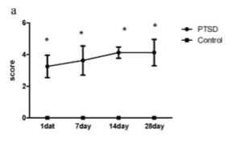
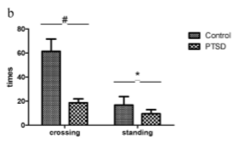
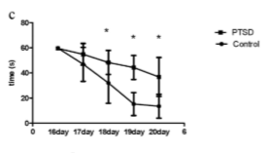
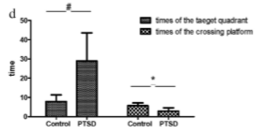
Results
Response rate test
Open-field test
Water Maze: Latency of Learning
Water Maze: Discovering the Platform
Notes:
Figure 1a-d page 891

Slide 9
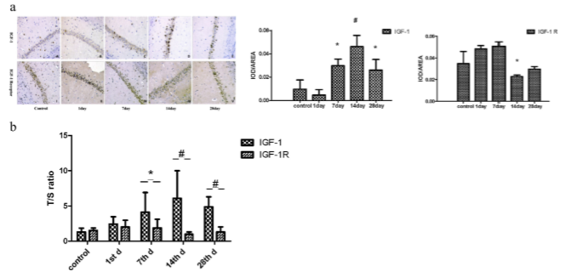
Results
Notes:
Figure 2a,b page 892

Slide 10
Class Discussion Questions About this (bad) Study
Do you feel this was a solid experimental design to test the hypothesis?
What are some assumptions the authors of this study made?
Do these assumptions add or detract from the efficacy of the study?
Do you have any issues with the data and the figures they chose to display?
Is SLS a good model for PTSD?
Can this study conclude anything about IGF-1?
Notes:
Experimental design
Results were confusing:
How was figure 1a scored?
How was figure 1b scored?
What do figure 1c and 1d mean?
There are no arrows on figure 2a (part 1?)
There are no units on figure 2a (parts 2 and 3?)
What is a T/S ratio and what are the units in figure 2b?

Slide 11
Conclusions
PTSD patients suffer social and behavioral abnormalities due to hippocampal atrophy.
The expression of IGF-1 is high during development, decreases with age, but increases in response to internal or external injury.
*Rats which experienced the SLS showed increased awareness, lowered desire to explore and learning and memory loss.
*Expression of IFG-1 increased in rats which underwent the SLS experience, but IGF-1R did not.
*A decline in IGF-1 may contribute to cognitive dysfunction and the lack of increase in IGF-R1 alongside IGF-1 may limit the positive effects of IGF-1.
*indicates conclusions the authors believe this study supports.

Slide 12
Stress-altered synaptic plasticity and DAMP signaling in the hippocampus-PFC axis; elucidating the significance of IGF-1/IGF-1R/CAMKIIα expression in neural changes associated with a prolonged exposure therapy
Ogunbele et al, Neuroscience, 2017
Study Hypothesis
Event-dependent changes in IGF-1R signaling as a response to traumatic stress and prolonged exposure therapy (PET) are involved in the regulation of inflammation and synaptic function
Thus, this study sought to determine whether a change in IGF-1/IGF-1R/CAMKIIα expression may represent specific changes in neural morphology and danger associated molecular pattern (DAMP) signaling in stress and modifications that occur in response to PET

Slide 13
Experimental Design
Subjects
Thirty Adult male Sprague-Dawley rats
Rats weighed between 250-300g
Controlled 12h light/12h dark conditions
Free access to food and water
Animal were divided into 2 groups
Traumatic stress group – n=20
Control group – n=10

Slide 14
Experimental Design
Traumatic Stress Model
(acute – predator exposure)
All animals were kept in cylindrical Plexiglas containers with the floor covered in cat food – the containers were placed into a metal cage with an adult cat
First event on Day 1: For 1 hour in light conditions, the cat was allowed to move freely around the rat container, but the two could not physically interact.
Second event on Day 10: same, but in dark conditions.
(chronic – elimination of social support by random cohort changes)
Between Day 1 and 31 rats were subjected to random, daily cohort changes to induce chronic psychosocial stress during the experiment period.
Authors note: no cat or cat material was allowed near the cage rotation cohort.
The last cage rotation was also the first (home cage) of the group
Control rats were kept in the same cages from Day 1-31 and were not subjected to cage rotation or predator exposure events
Notes:
What does the authors note mean?

Slide 15
Experimental Design
Prolonged Exposure Therapy
The traumatic stress was induce through predator exposure and psychosocial stressors.
At day 40 a group of n=10 naïve traumatically stressed rats were re-exposed to a cat meow tone, unrelated causative stimulus.
Animals were exposed to the PET stimulus (cat meow tone) for 5 minutes a day in dark conditions through speakers in the conditioning chamber for 20 days.
On Day 51, after 20 days, the animals were re-examined for anxiety-linked behavior.

Slide 16
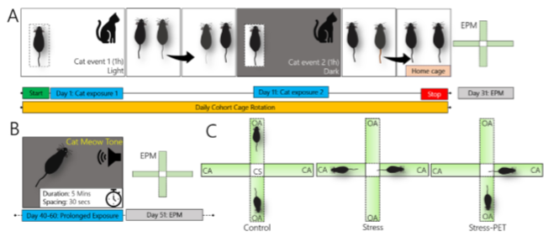
Experimental Design

Slide 17
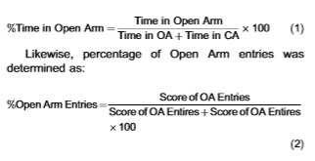
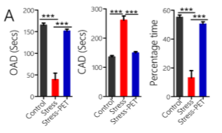
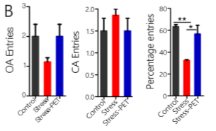
Data Collection and Analysis
Elevated Plus Maze – Behavior test for anxiety
Animals moved into training area 24 hours in advance
Soundproof room, adequate lighting, HD camera for recording
5 min in EPM
Open-space avoidance of open arms (OA) was observed and open-arm duration (OAD), closed-arm duration and percentage time was determined.
Notes:
Elevated Plus Maze – Behavior test for anxiety

Slide 18
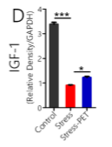
Data Collection and Analysis
Western blotting and protein quantification
10ul of brain tissue lysate containing 10ug of protein was processed
GAPDH was used as control and amounts of IGF-1 were calculated
Notes:
IGF-1 decreased significantly in brains of stress condition group and increased (P<0.05) in stress followed by PET group. However, compared to control group, IGF-1 remained relatively low in both groups – suggesting a significant loss.

Slide 19
Data Collection and Analysis
Immunofluorescence
Animals were anesthetized via isoflurane, perfused transcardially using PBS followed by 4% paraformaldehyde.
Whole brains were harvested and cranial sections 50µm apart (2.2mm behind the bregma) were prepared for microscopic analysis.
n=12 fields of view for each of 5 sections were used
Stains/Antibodies used in this study (colors depict secondary antibody emission):
IGF-1R GABA
DAPI (nucleus) CHaT
NeuN CD11b/c
Synaptophysin HMGB1
CaMKIIα TLR4
PSD-95 VGLUT2
KCa2.2 Tyrosine Hydroxylase
Notes:
The NeuN protein is localized in nuclei and perinuclear cytoplasm of most of the neurons in the central nervous system of mammals.
Synaptophysin is an integral membrane glycoprotein; presynaptic vesicular traﬃcking protein
Ca²⁺/CaM-activated protein kinases (CaMKs), a family of enzymes that can alter the function of proteins by phosphorylation, it is central to the coordination and execution of Ca²⁺ signal transduction. In the synaptic terminals, the Ca²⁺/ATP-dependent interaction of CaMKIIα and syntaxin play an important role in the regulation of exocytosis of neurotransmitter vesicles
PSD -95 : postsynaptic densities
KCa2.2: calcium-dependent potassium channels

Slide 20
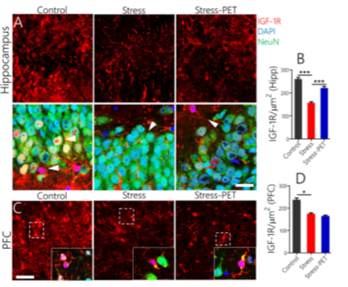
ICC Results – IGF-1R
D corresponds to the results of the first study, IGF-1R lags behind (at least in PFC)
Notes:
Fig. 3. (A) IGF-1R expression decreased signiﬁcantly in the hippocampus of naı¨ve stressed animals when compared with the control (p < 0.001).
After prolonged exposure therapy (PET), a signiﬁcant increase in IGF-1R was observed when the Stress-PET group was compared with the Stress group (p < 0.001; scale bar=20 mm).
(B) Bar chart (mean ± SEM) representing the statistical changes observed in the DG.
(C) Like the observations in the hippocampus, IGF-1R expression reduced signiﬁcantly in the PFC of naı¨ve stressed rats (p < 0.05) when compared with the control (scale bar=20 mm; inset = 10 mm). However, no signiﬁcant change was seen when the Stress group was compared with the Stress-PET.
(D) Statistical analysis (One-Way ANOVA) depicting the change in IGF-1R expression in the PFC neurons.

Slide 21
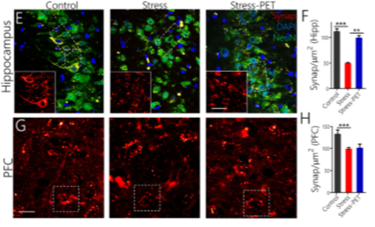
ICC Results - Synaptophysin
Notes:
(E) Presynaptic vesicular traﬃcking protein (synaptophysin) was reduced in the hippocampus of naı¨ve stressed rats; when compared with the control (p < 0.001). After a prolonged exposure therapy (Stress-PET), we observed an increase in synaptophysin expression; when compared with the Stress group (p < 0.01; scale bar=20 mm; inset = 20 mm). (F) Bar chart depicting the change in synaptophysin for Stress and Stress-PET groups. (G) Like the observation in the hippocampus, synaptophysin decreased signiﬁcantly in the PFC of traumatic stress rats when compared with the control (p < 0.001; scale bar=10 mm). However, no signiﬁcant change was recorded when the Stress-PET was compared with the Stress group. (H) Expression of synaptophysin in the PFC under each condition

Slide 22
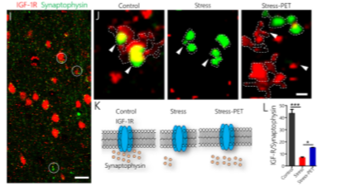
ICC Results – IGF-1R/ Synaptophysin co-localization
Notes:
co-localized IGF-1R and synaptophysin in typical cortical neurons.
(J) In the stressed and stress-PET groups, there was a displacement of the overlap when compared to the control

Slide 23
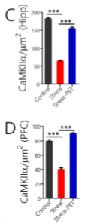
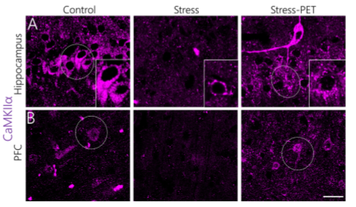
ICC Results – CaMIIKα
Ca²⁺/Calmodulin-activated protein kinases
Notes:
CaMKIIa is involved in the regulation of LTP and glutamatergic neurotransmission. Calcium movement during an LTP event activates Ca-dependent potassium channels, which are co-localized with CaMKIIa at post synaptic densities.
Furthermore, CaMKIIa has been shown to attenuate the inflammatory signaling mechanism of Akt.mTOR and MAPK/ErK.
Fig. 4. (A) Representative confocal images showing the expression of hippocampal CaMKIIa (scale bar=20 mm, inset = 10 mm).
(B) Confocal images showing a decrease in the expression of CaMKIIa in the PFC of naı¨ve stressed rats (p < 0.001). CaMKIIa expression was rescued after a prolonged exposure therapy (p < 0.001).
(C) Hippocampal CaMKIIa levels during stress (p < 0.001) was rescued after a prolonged exposure therapy (Stress vs Stress-PET; p < 0.001).
(D) Bar chart depicting a change in PFC CaMKIIa.

Slide 24
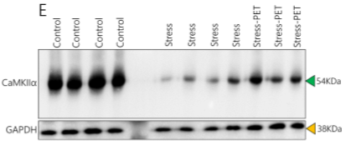
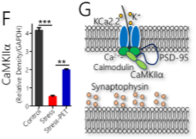
ICC Results – CaMIIKα
ICC Results – CaMIIKα
Ca²⁺/Calmodulin-activated protein kinases
Notes:
(E) Protein immunoblotting and quantiﬁcation of CaMKIIa in brain tissue lysate.
(F) Bar chart depicting the signiﬁcant reduction in CaMKIIa (relative density) in traumatic stress rats (p < 0.001 vs the control). Like the observation in confocal imaging, an increase was seen in the Stress-PET group (p < 0.01); after normalization with GAPDH.
(G) Schematic summary of the interaction between CaMKIIa and IGF-1R at synaptic sites.

Slide 25
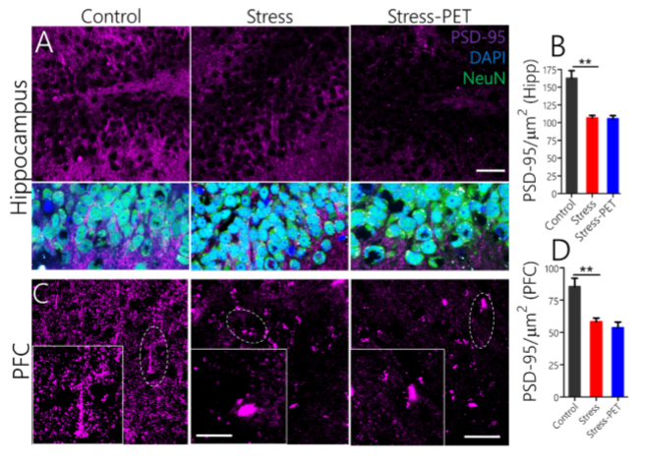
ICC Results – PSD-95
Postsynaptic densities
Notes:
Together a decrease in IGF-1,IGF-1R, and CaMKIIa expression was linked to a reduction in post-synaptic marker PSD-95.
Fig. 5. (A) Signiﬁcant reduction in postsynaptic densities (PSD-95) was observed in the hippocampus of Stress, and Stress-PET rats (p < 0.01 and p < 0.01; scale bar=20 mm).
(B) Bar chart depicting a statistical loss of PSD-95 in the hippocampus of naı¨ve stressed rats, and after PET.
(C) Similarly, the expression of PSD-95 was reduced in the prefrontal cortex of Stress and Stress-PET groups when compared with the control (p < 0.01; scale bar=20 mm; inset = 5 mm). No signiﬁcant diﬀerence was seen in PSD-95 expression in the Stress-PET group was compared with the Stress group.
(D) Statistical analysis of change in PSD-95 distribution in the PFC.

Slide 26
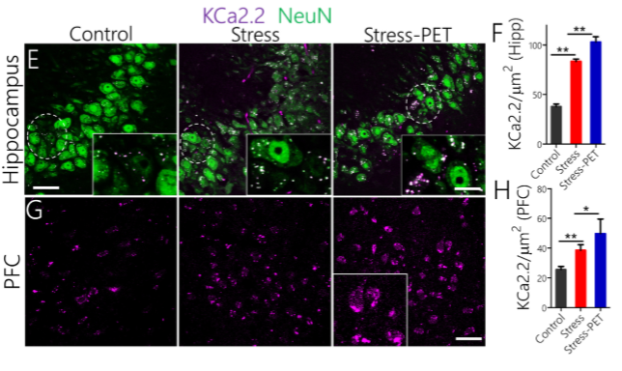
ICC Results – KCa2.2
Calcium-dependent potassium channels
Notes:
(E) Distribution of calcium-dependent potassium channels (KCa2.2) increased c in the hippocampus of naı¨ve stressed rats when compared with the control (p < 0.01; scale bar=20 mm, inset = 5 mm). Furthermore, a signiﬁcant increase in KCa2.2 expression was recorded after PET was implemented (when the Stress-PET was compared with the Stress group) (p < 0.01).
(F) Bar chart representing the statistical analysis for KCa2.2 re-distribution in the hippocampus of naı¨ve stressed rats, and after PET (Stress-PET).
(G) KCa2.2 expression increased in the PFC of stressed rats when compared with the control (p < 0.01). Like the observations in hippocampus, KCa2.2 expression increased when Stress-PET was compared with the Stress group (p < 0.05; scale bar=20 mm).
(H) Bar chart showing the diﬀerential expression of KCa2.2 in the PFC.

Slide 27
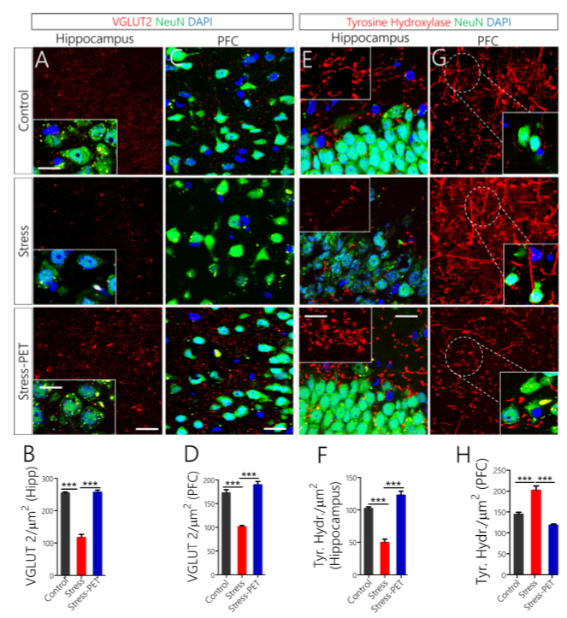
ICC Results – VGLUT2 & Tyrosine Hydroxylase
Notes:
VGLUT: Vesicular glutamate transporter 1 is a protein that is a vesicle-bound, sodium-dependent phosphate transporter
Tyrosine Hydroxylase: (or tyrosine 3-monooxygenase) is the enzyme responsible for catalyzing the conversion of the amino acid L-tyrosine to L-3,4-dihydroxyphenylalanine
Fig. 6. (A) Vesicular glutamate transporter (VGLUT 2) expression decreased in the hippocampus of stressed rats when compared with the control (p < 0.001). VGLUT2 expression was rescued in the hippocampus of Stress-PET rats when compared with the stressed group (p < 0.001; scale bar=20 mm; inset = 5 mm).
(B) Hippocampal VGLUT 2 expression quantiﬁed in traumatic stress and PET.
(C) VGLUT2 expression decreased in the PFC of stressed rats (p < 0.001) when compared with the control. A normalized cortical VGLUT2 expression was observed in stressed rats subjected to PET; when compared to naı¨ve stressed rats (p < 0.001; scale bar=20 mm).
(D) Graphical representation of change in cortical VGLUT2 distribution.
(E) Tyrosine hydroxylase (TH) expression decreased in the hippocampus of naı¨ve stressed rats when compared with the control (p < 0.001). After the prolonged exposure therapy in the Stress group, the expression of tyrosine hydroxylase increased; when compared with the Stress group (p < 0.001; scale bar=10 mm; inset = 10 mm).
(F) Bar chart depicting a statistical change in hippocampal tyrosine hydroxylase expression for Stress and Stress-PET rats.
(G) TH expression increased signiﬁcantly in the PFC of naı¨ve stressed rats when compared with the control (p < 0.001). After a phase of PET, the expression of tyrosine hydroxylase reduced signiﬁcantly in the Stress group (p < 0.001); when compared with the naı¨ve stressed group (scale bar=20 mm).
(H) Graphical representation of statistical change in cortical tyrosine hydroxylase in traumatic stress and PET

Slide 28
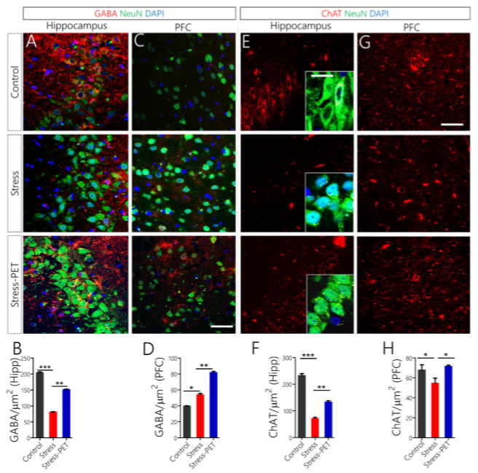
ICC Results – GABA & CHaT
Notes:
GABA: inhibitory neurostransmitter
CHaT: a transferase enzyme responsible for the synthesis of the neurotransmitter acetylcholine.
Fig. 7. (A) a decrease in GABA (inhibitory neurotransmitter) was observed in the hippocampus when the Stress group was compared with the control (p < 0.001). However, after the PE therapy, the distribution of GABA increased signiﬁcantly in the hippocampus of Stress-PET rats (p < 0.01; scale bar=20 mm).
(B) Bar chart depicting the statistical change in hippocampal GABA expression.
(C) An increase in GABA was recorded in the PFC of naı¨ve stressed rats; when compared with the control (p < 0.05). Furthermore, in the Stress-PET group, the distribution of GABA increased signiﬁcantly when compared with the naı¨ve stressed group (p < 0.01; scale bar=20 mm).
(D) Bar chart depicting a statistical change in cortical GABA distribution in stress rats, and after a prolonged exposure therapy.
(E) Expression of ChAT decreased in the hippocampus of naı¨ve stressed rats when compared with the control (p < 0.001). Subsequent analysis showed that ChAT increased in the hippocampus of Stress-PET rats; when compared with the naı¨ve stressed group (p < 0.01; scale bar=20 mm; inset = 5 mm).
(F) Statistical representation of a change in hippocampal ChAT expression. (G) ChAT expression reduced in the PFC of naı¨ve stressed group; when compared with the control (p < 0.05). After a PET (Stress-PET), cortical expression of ChAT was upregulated versus the Stress group (p < 0.05; scale bar=20 mm).
(H) Bar chart showing the statistical change in cortical ChAT expression.

Slide 29
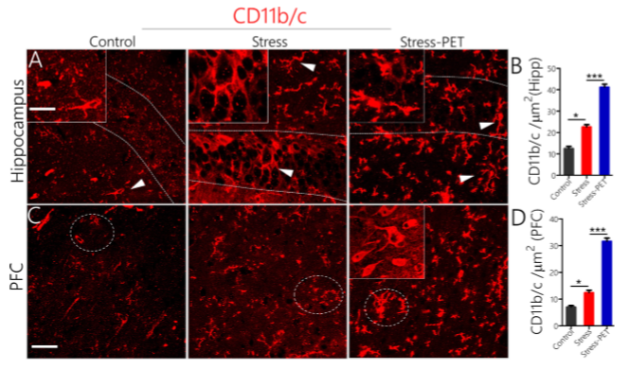
ICC Results – CD11b/c
Notes:
Neuro inflammatory changes relative to stress and PET by microglia activation
Fig. 8. (A) Representative confocal images showing the activation of microglia (CD11b/c) in the hippocampus of Stress and Stress-PET rats. Microglia activation increased in the Stress group when compared with the control (p < 0.05). Further increase in microglia was recorded in the Stress-PET group when compared with the Stress group (p < 0.001; scale bar=20 mm, inset = 5 mm).
(B) Bar chart showing statistical comparison of hippocampal microglia (CD11b/c) count in Control, Stress and Stress-PET groups.
(C) Confocal images of activated microglia in the PFC. Like the hippocampus, an increase was observed in the Stress group (p < 0.05), while the Stress-PET showed a signiﬁcant increase (p < 0.001; scale bar=20 mm).
(D) Bar chart depicting a statistical increase in cortical activated microglia in the Stress and Stress-PET group.

Slide 30
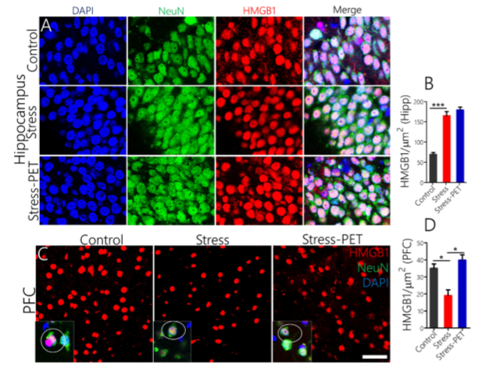
ICC Results – HMGB1
Notes:
HMGB1: high mobility group box protein is a ligand for TRL4 and causes the release of IL-1β and drives downstream increase in mTOR and MAPK/ErK pathways. Extra-neuronal accumulation of HMGB1 is associated with advanced stages of neuroinflammation
TRL4
Fig. 9. (A) Expression of HMGB1 increased signiﬁcantly in the hippocampal neurons of naı¨ve stressed rats when compared with the control (p < 0.001; scale bar=15 mm). For the Stress-PET group, no signiﬁcant change in HMGB1 was observed when compared with the naı¨ve stressed group (ns).
(B) Bar chart representing the change in hippocampal HMGB1 expression in naı¨ve stressed rats, and after prolonged exposure therapy.
(C) Decline in cortical HMGB1 expression was observed in naı¨ve stressed rats when compared with the control (p < 0.05). However, for the StressPET group, the expression of HMGB1 increased in the cortex when compared with the naı¨ve stressed group (p < 0.05; scale bar=20 mm, 10 mm).
(D) Quantiﬁcation of changes in HMGB1 expression in the PFC.

Slide 31
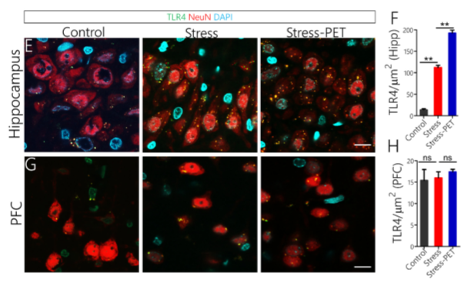
ICC Results – TRL4
Notes:
(E) Hippocampal TLR4 expression increased in naı¨ve stressed rats (p < 0.01; versus the control). A signiﬁcant increase was also observed after the PE therapy (Stress-PET), when compared with the naı¨ve stressed group (p < 0.01; scale bar=20 mm).
(F) Statistical changes in TLR4 expression in hippocampus of stressed rats, and after a PET.
(G) No signiﬁcant change in TLR4 was seen in the PFC of naı¨ve stressed, and Stress-PET groups when compared with the control (scale bar=5 mm).
(H) Statistical analysis for the expression of TLR4 in the PFC of Stress and Stress-PET animals.

Slide 32
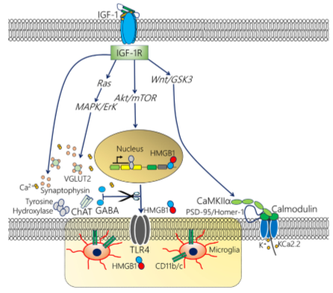
Schematic summary of the possible link between IGF-1R signaling, synaptic changes, neurotransmitter function and inﬂammatory response
Notes:
Fig. 10. Schematic summary of the possible link between IGF-1R signaling, synaptic changes, neurotransmitter function and inﬂammatory response. This represents multiple complex interacting pathways and potential areas for future investigation regarding the role of IGF-1R in neural stress response.
IGF-1R has three major signaling pathways (Ras, Wnt/GSK3 and Akt/mTOR). While IGF-1R directly modulates synaptic activity (Synaptophysin, CaMKIIa and IGF-1), through its other signaling mechanisms, IGF-1R may regulate the pattern of inﬂammatory response (Microglia, HMGB1 and TLR4).
Importantly, CaMKIIa, in the Wnt/GSK3 signaling pathway, can attenuate Ras and Akt/mTOR pathways. Furthermore, CaMKIIa has been shown to be directly linked to the regulation of LTP. Ultimately, through multiple interacting downstream pathways, a change in IGF-1R – as a response to stress - may modulate phasic synaptic and inﬂammatory response in the brain.

Slide 33
Questions and Conclusions
Was this a good model for traumatic stress? Better than the previous study?
Should IGF-1 be explored as a therapeutic to be administered along side PET?
Traumatic stress response and subsequent PET are involved in event-dependent alteration of the IGF-1/IGF-1R/CaMKIIα signaling pathways.
IGF-1 decreased significantly in brains of stress condition group and increased (P<0.05) in stress followed by PET group. However, compared to control group, IGF-1 remained relatively low in both groups – suggesting a significant loss.
A possible link exists between IGF-1R signaling, synaptic changes, neurotransmitter function and inﬂammatory response to stress.
A change in expression of IGF-1 and IGF-1R is associated with synaptic and inflammatory changes
PET can attenuate or rescue some of the detrimental effects of traumatic stress
Notes:
Previous studies have shown that a decrease in neural IGF-1e is associated with traumatic brain injury and stress. As such, post-stress administration of exogenous IGF-1 reduced the observed stress response.
Previous studies have also shown that the activation of IGF-1R promotes the presynaptic release of glutamate and the cellular synthesis of tyrosine hydroxylase – which favor dopaminergic transmission. Furthermore, IGF-1 is also known to directly regulate the activity of dopamine and glutamate at post-synaptic terminals by directly altering the activity of NMDAR and dopaminergic D2R – thus IGF-1/IGF-1R may be linked to the combined regulation of dopaminergic and glutamatergic neurotransmission.

Slide 34
A Novel Approach via surface modification of degradable polymers with adhesive DOPA-IGF-1 for neural tissue engineering
Zhang et al, Journal of Pharmaceutical Sciences, 2019
Study Hypothesis
Surface modification of implants can promote nerve regeneration and functional reconstruction of damaged tissue.
Thus, this study determine the best surface coating to bind IGF-1 and stimulate human umbilical mesenchymal stem cells to secrete neurotrophic factors to direct PC12 cell growth and development.

Slide 35
Experimental Design
Compare commercially available (cIGF-1) to surface functionalized poly-(lactic-co-glycolic) (PLGA)
Bioactive surface modifications:
Y-IGF-1 - Recombinant Tyr-Lys-Tyr-Lys-Tyr (YKYKY-IGF-1) residues on the C terminal of IGF-1
DOPA-IFG-1 –composed of 3,4-dihydorxy-l-phenylalanine and lysine (hydrolyzed tyrosine)
Culture human umbilical cord mesenchymal stem cells (HUMSCs) and promote neurotrophic release to increase bioactivity and neurite outgrowth of PC12 cells.
Notes:
DOPA-IFG-1 –is a widely used binding and conjugation agent

Slide 36
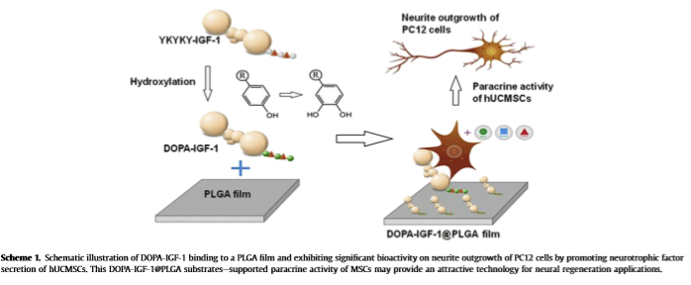
Experimental Design

Slide 37
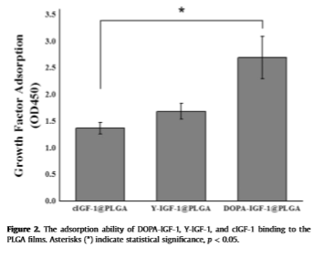
Results – Absorption Ability
Notes:
Figure 2. The adsorption ability of DOPA-IGF-1, Y-IGF-1, and cIGF-1 binding to the PLGA ﬁlms. Asterisks (*) indicate statistical signiﬁcance, p < 0.05.

Slide 38
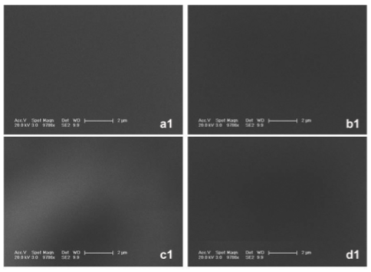
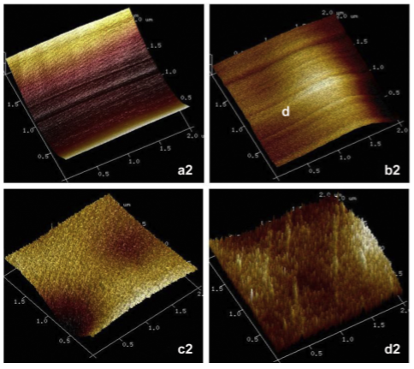
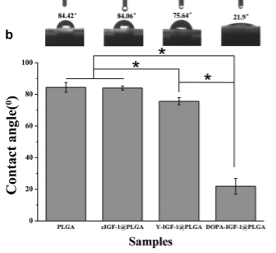
Results – Surface Morphology
SEM
AFM
Goniometry
Notes:
Figure 3. SEM and AFM images of the surface of different PLGA ﬁlms. (a) PLGA, (b) CIGF-1@PLGA, (c) Y-IGF-1@PLGA, (d) DOPA-IGF-1@PLGA. The scale bars for SEM are 2 mm, the scale scise for AFM is 2 mm 2 mm.

Slide 39
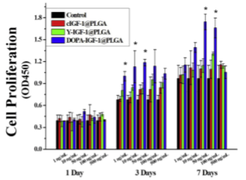
Results – Cell Proliferation
Notes:
Figure 5. Proliferation of hUCMSCs for 1, 3, and 7 days on PLGA, cIGF-1@PLGA, Y-IGF1@PLGA, and DOPA-IGF-1@PLGA ﬁlms, and the concentrations of cIGF-1, Y-IGF-1, and DOPA-IGF-1 solutions for the protein immobilization were 1, 10, 50, 100, and 500 ng/ mL, respectively. Asterisks (*) indicate statistical signiﬁcance, p < 0.05.

Slide 40
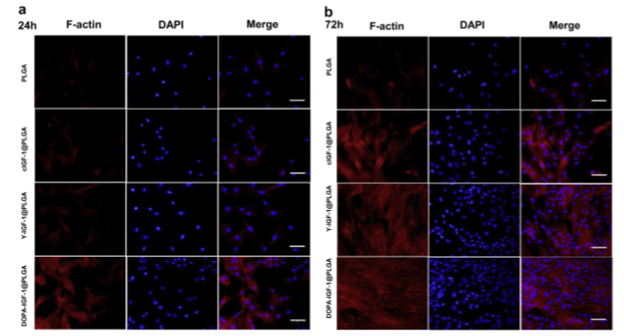
Results – ICC
Notes:
Figure 6. (a and b) Cell morphology of hUCMSCs grown on the PLGA, cIGF-1@PLGA, Y-IGF-1@PLGA, and DOPA-IGF-1@PLGA ﬁlms were assayed by confocal laser scanning microscope. The actin ﬁlaments (red) were stained by phalloidin and the cell nucleus (blue) was stained by DAPI. Scale bars are 100 mm.

Slide 41
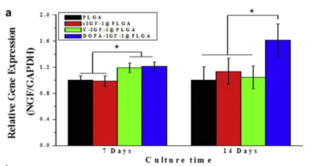
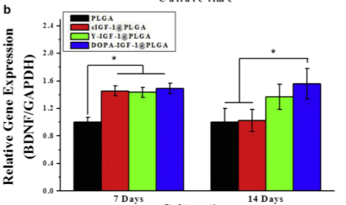
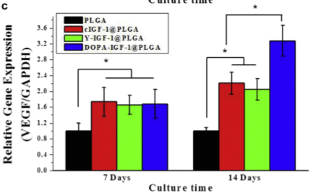
Results – Gene Expression
Notes:
Figure 7. Neurotrophic factors expressed by the hUCMSCs cultured on different substrates assessed by the mRNA levels for 7 and 14 days. The expression of three neurotrophic factors genes
NGF,
BDNF,
VEGF) was analyzed by qRT-PCR. Asterisks (*) indicate statistical signiﬁcance, p < 0.05.

Slide 42
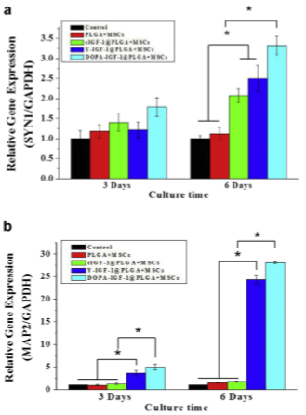
Results – Gene Expression
Notes:
Figure 11. PC12 cells were culturedon the different samples for 3 and 6 days. SYN1 (a) and MAP2 (b) genes were signiﬁcantly up-regulated for the group of DOPA-IGF1@PLGA þ MSCs. Asterisks (*) indicate statistical signiﬁcance, p < 0.05

Slide 43
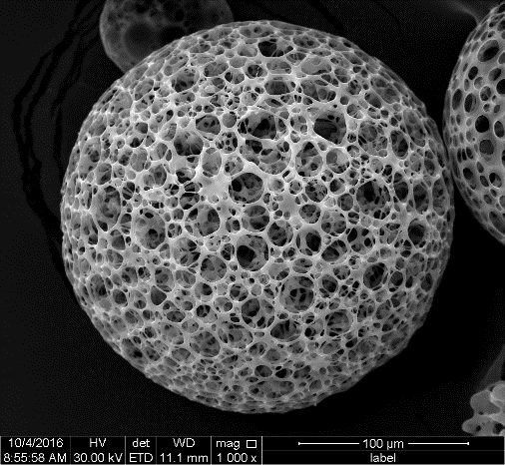
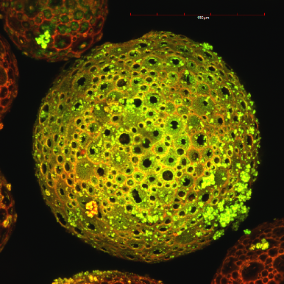
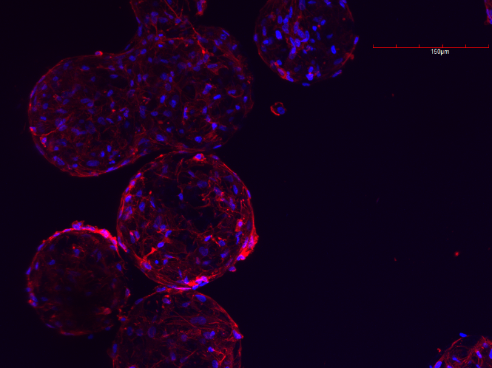
Conclusion – Where’s the Nanoparticle Bro?
This study illustrated that a 2D PLGA film can be coated with DOPA-IGF-1 and seeded with HUMSCs to release neurotrophic factors and increase the differentiation and bioactivity of PC12 cells.
I believe this technology could be applied to develop micro/nanoparticles…

Slide 44
Overall Conclusions
IGF-1 is produced by all brain cells throughout human lifespan with the greatest amounts secreted during development and gradually declining throughout adulthood
Traumatic stress increases the amount of circulating IGF-1 but not IGF-1R (Zhang et al (1st paper))
Greater effects of IGF-1R, synaptophysin, and co-localization of the two were observed in the hippocampus than the PFC in PET groups compared to stress alone. (Ogunbele et al)
Effects of PET over stress alone were observed equally in CaMKIIα and KCa2.2 in the hippocampus and PFC. (Ogunbele et al)
IGF-1 can promote paracrine activity among different cell types to promote neurogenic activity. (Zhang et al (3rd paper))
There is a gap in micro/nanoparticle technology to deliver or IGF-1, promote IGF-1R upregulation or to stimulate paracrine activity.

